Slide 1
Week 1:
Introduction and Computer Simulation

Slide 2
OUTLINE
What is probability?
Types of probability problems
Probabilistic modeling
Anaylsis versus computer simulation
Why use computer simulation?
Computer simulation of random experiments
Determining characteristics of random variables
Real-world example: digital communication

Slide 3
What is Probability?
Probability is the chance that a given event will occur.
Examples: the probability that it will rain tomorrow, the probability that you will win a lottery.
Common thread of the examples given above is the presence of a random experiment, a set of outcomes and probabilities assigned to these outcomes.
In the lottery case, for example, the experiment is the drawing, the outcomes are the lottery number sequences and the probabilities assigned are 1/N assuming that N is the total number of lottery number sequences.
Another common thread is statistical regularity which means that averages obtained in long sequences of repetitions of random experiments consistently yield approximately the same value.

Slide 4
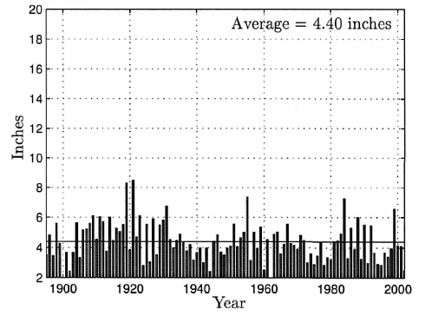
What is Probability?
Average rainfall in the summer in Arizona from 1895 to 2002 is 4.40 inches.
We can not predict the rainfall amounts for any given summer. However, probability theory enables us to predict the behavior of random experiments in the long run.
Figure source: S. M. Kay, Intuitive Probabilty and Random Processes Using MATLAB, Springer, 2006.

Slide 5
Types of Probability Problems
Probabilistic methods are divided into two distinct types (discrete and continuous) based on the mathematics required to determine probabilities.
Discrete approach is used when the number of outcomes is finite or infinite but countable. Otherwise, continuous model must be used.
Example: Suppose that there are N persons in an office. Consider the number of persons that are talking on the phone anytime between 9:00 AM and 9:10 AM. Possible outcomes are 0,1,2,…, N (discrete). If we are interested in the length of time a person is on the phone during that time period, the outcomes may be anywhere from 0 to 10 minutes (continuous).
In the first case, we can assign probabilities to the outcomes since the number of outcomes is finite. In the second case, it is not possible to assign a nonzero probability to each outcome as the outcomes are continuous.

Slide 6
Probabilistic Modeling
Probability models are simplified mathematical approximations to reality.
On the one hand, they should be comprehensive enough to represent characteristics of the random experiment, on the other hand they should be as simple as possible to be used in practice.
Discrete or continuous probability models are used according to the underlying random experiment.
In this course, we will assume that models are perfect and can be used to determine probabilities.
In practice, the user must choose a reasonable model for a given application.

Slide 7

Probabilistic Modeling
Discrete Probability Model Example:
Suppose that there are N persons in an office. Propose a model for the probability of the number of persons being on the phone in the given 10-minute interval.
We can imagine a relationship between tossing a coin and the event of being on the phone (if heads appears, a person is on the phone, otherwise a person is not on the phone!). Then, the probability of the number of persons being on the phone is equal to the probability of the number heads in N coin tosses (in succesion or simultaneously).
We will see in the course that solution is the Binomial distribution. The probability of k heads out of N coin tosses is given by
$$P\left[k\right]=\left(\begin{matrix}N \\ k\end{matrix}\right)p^{k}{\left(1−p\right)}^{N−k}, k=0,1,…,N−1$$

Slide 8
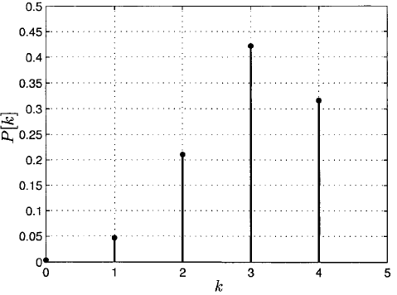

Probabilistic Modeling
The model must be modified to account for invalid assumptions, but it should exhibit the property of parsimony. Some objections to the model might be
p, changes from person to person.
Events are not independent.
p changes over time.
$$p=0.75, N=4.$$
Figure source: S. M. Kay, Intuitive Probabilty and Random Processes Using MATLAB, Springer, 2006.

Slide 9
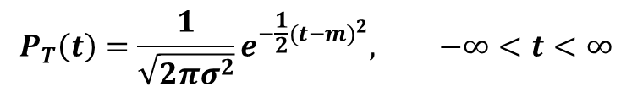
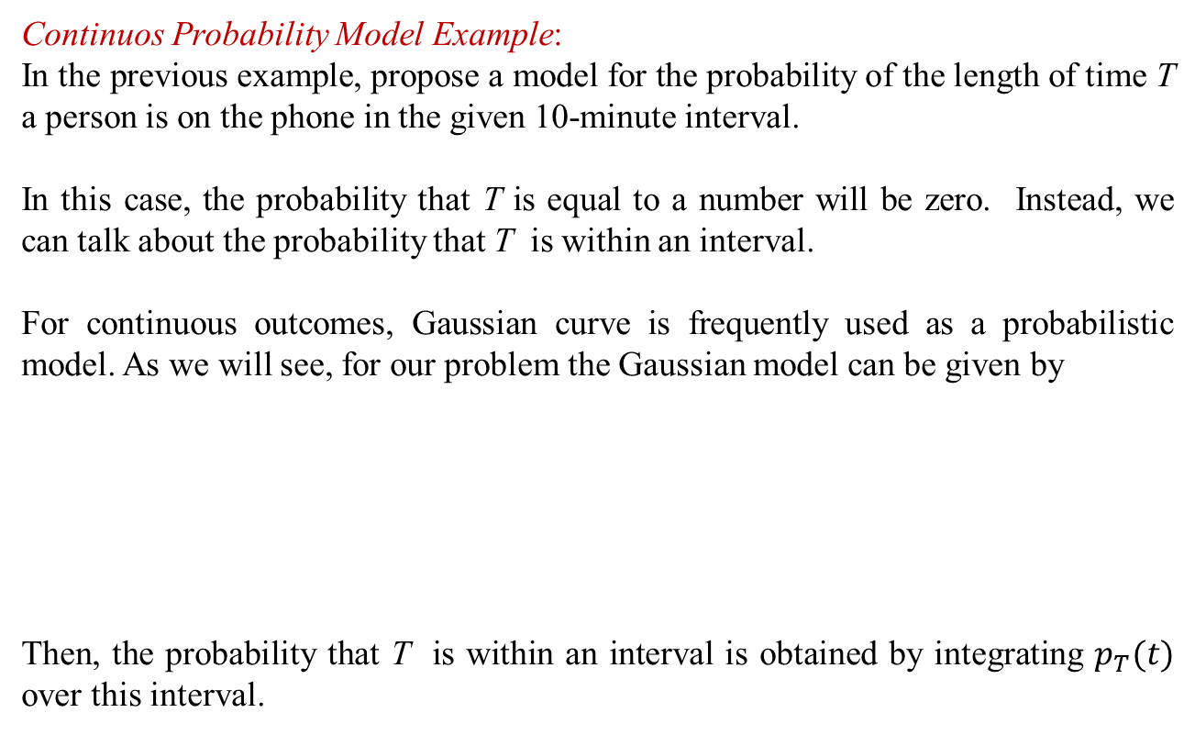
Probabilistic Modeling
Continuos Probability Model Example:
In the previous example, propose a model for the probability of the length of time T a person is on the phone in the given 10-minute interval.
In this case, the probability that T is equal to a number will be zero. Instead, we can talk about the probability that T is within an interval.
For continuous outcomes, Gaussian curve is frequently used as a probabilistic model. As we will see, for our problem the Gaussian model can be given by
Then, the probability that T is within an interval is obtained by integrating $p_{T}(t)$ over this interval.
$$P_{T}\left(t\right)=\frac{1}{\sqrt{2πσ^{2}}}e^{−\frac{1}{2}{(t−m)}^{2}}, −∞<t<∞$$

Slide 10
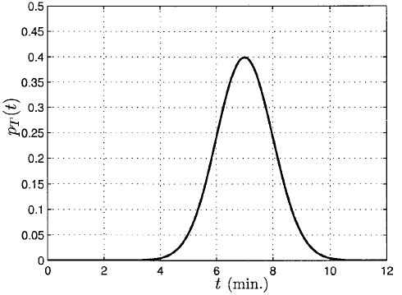
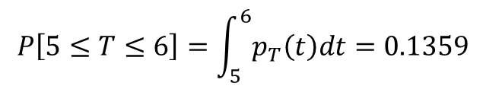
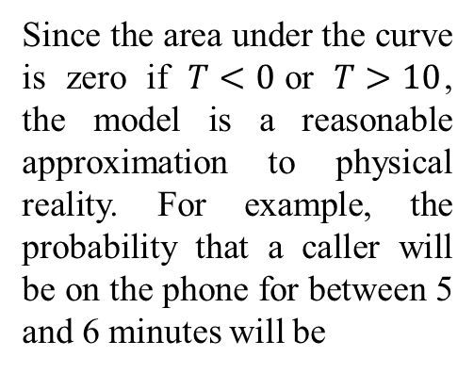

Probabilistic Modeling
$$σ=1, m=7$$
Since the area under the curve is zero if $T<0$or $T>10$, the model is a reasonable approximation to physical reality. For example, the probability that a caller will be on the phone for between 5 and 6 minutes will be
$$P\left[5≤T≤6\right]=\int_{5}^{6}{p_{T}\left(t\right)dt}=0.1359$$
Figure source: S. M. Kay, Intuitive Probability and Random Processes Using MATLAB, Springer, 2006.

Slide 11
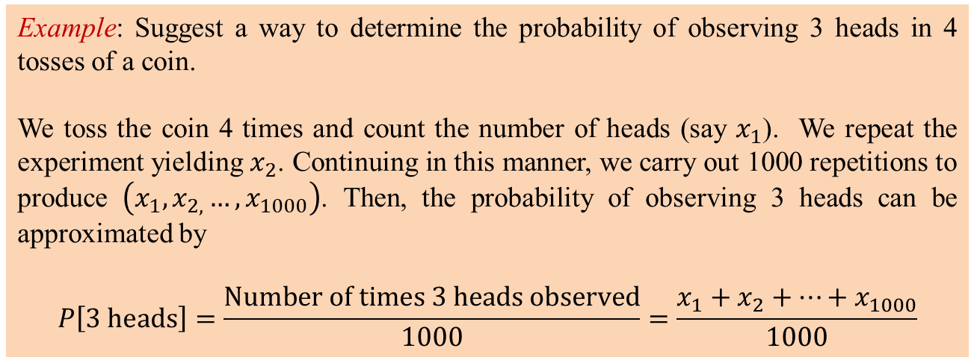
Analysis Versus Computer Simulation
For many practical problems, it is not possible to determine probability functions.
If we have a model for the random experiment, we can conduct the experiment a large number of times to obtain an approximate probability.
Example: Suggest a way to determine the probability of observing 3 heads in 4 tosses of a coin.
We toss the coin 4 times and count the number of heads (say $x_{1}$). We repeat the experiment yielding $x_{2}$. Continuing in this manner, we carry out 1000 repetitions to produce $\left(x_{1},x_{2,}…,x_{1000}\right)$. Then, the probability of observing 3 heads can be approximated by
$$P\left[3 \text{heads}\right]=\frac{\text{Number} \text{of} \text{times}\text{ 3 }\text{heads} \text{observed}}{1000}=\frac{x_{1}+x_{2}+…+x_{1000}}{1000}$$

Slide 12
Analysis Versus Computer Simulation
This approach is tedious. Therefore, it is important to simulate this procedure.
Today, we have strong computers carrying out a calculation 1,000,000 times in seconds. What is needed, then, is a way to simulate the toss of a coin.
Most scientific software packages have built in random number generators. For example, in MATLAB a number in the interval (0,1) can be produced with the statement x = rand(1,1). The number is chosen at random. Hence, it is equally likely to be anywhere in the (0,1) interval.
As a result, a number in the interval (0,1/2] will ve observed with probability 1/2. Similarly, a number in the interval (0,0.75] will be observed with probability 0.75.
Any discrete random experiment can be simulated by using this approach.

Slide 13
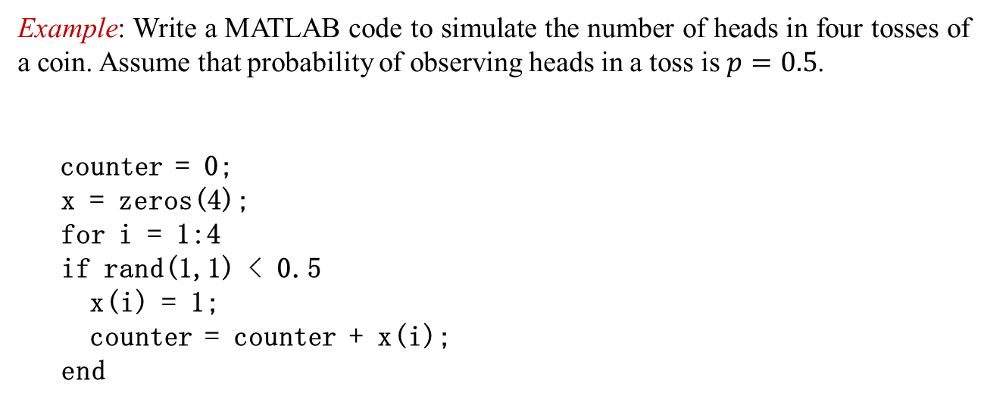
Analysis Versus Computer Simulation
Example: Write a MATLAB code to simulate the number of heads in four tosses of a coin. Assume that probability of observing heads in a toss is $p=0.5$.
counter = 0;
x = zeros(4);
for i = 1:4
if rand(1,1) < 0.5
x(i) = 1;
counter = counter + x(i);
end

Slide 14
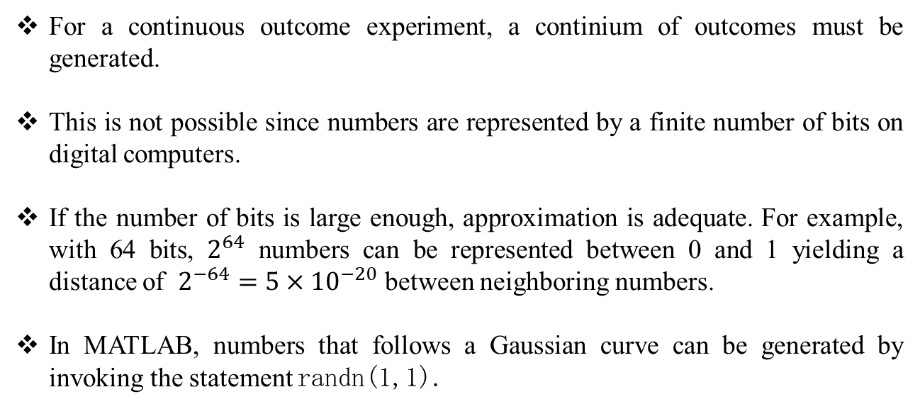
Analysis Versus Computer Simulation
For a continuous outcome experiment, a continium of outcomes must be generated.
This is not possible since numbers are represented by a finite number of bits on digital computers.
If the number of bits is large enough, approximation is adequate. For example, with 64 bits, $2^{64}$ numbers can be represented between 0 and 1 yielding a distance of $2^{−64}=5×{10}^{−20}$ between neighboring numbers.
In MATLAB, numbers that follows a Gaussian curve can be generated by invoking the statement randn(1,1).

Slide 15
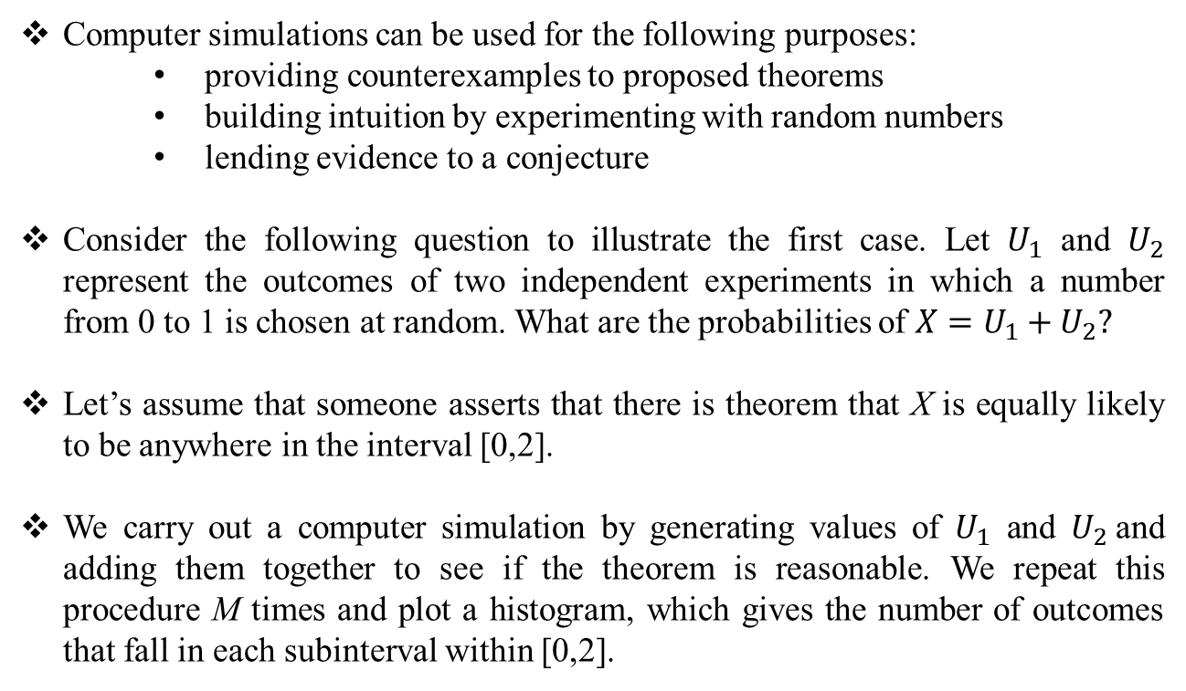
Why Use Computer Simulation?
Computer simulations can be used for the following purposes:
providing counterexamples to proposed theorems
building intuition by experimenting with random numbers
lending evidence to a conjecture
Consider the following question to illustrate the first case. Let $U_{1}$ and $U_{2}$ represent the outcomes of two independent experiments in which a number from 0 to 1 is chosen at random. What are the probabilities of $X=U_{1}+U_{2}?$
Let’s assume that someone asserts that there is theorem that X is equally likely to be anywhere in the interval [0,2].
We carry out a computer simulation by generating values of $U_{1}$ and $U_{2}$and adding them together to see if the theorem is reasonable. We repeat this procedure M times and plot a histogram, which gives the number of outcomes that fall in each subinterval within [0,2].

Slide 16
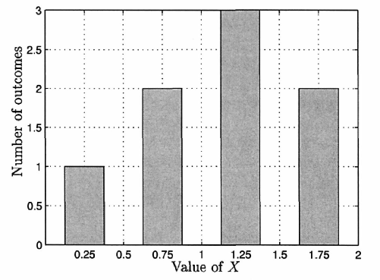
Why Use Computer Simulation?
M = 8
Subintervals (bins): [0,0.5], (0.5,1], (1,1.5], (1.5,2].
Figure source: S. M. Kay, Intuitive Probability and Random Processes Using MATLAB, Springer, 2006.

Slide 17
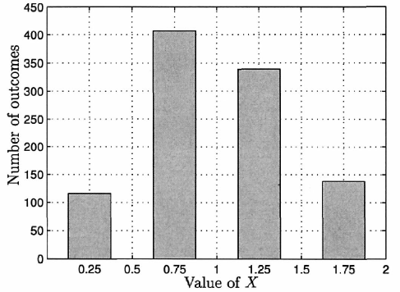
Why Use Computer Simulation?
M = 1000
bins: [0,0.5], (0.5,1], (1,1.5], (1.5,2].
It is clear that values of X are not equally likely. We have generated a counterexample to the proposed theorem.
Figure source: S. M. Kay, Intuitive Probability and Random Processes Using MATLAB, Springer, 2006.

Slide 18
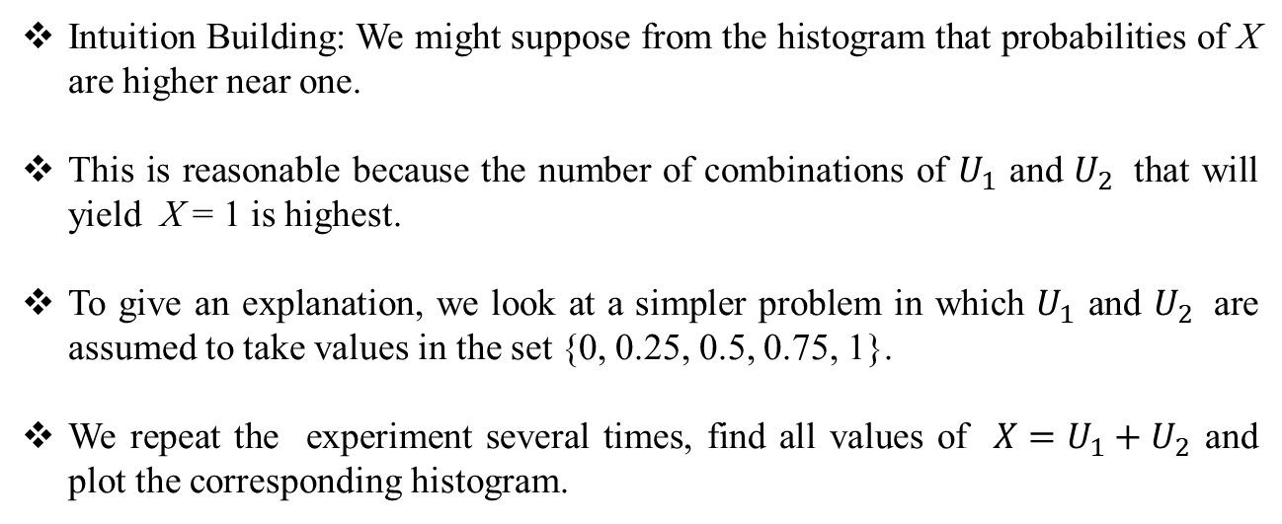
Why Use Computer Simulation?
Intuition Building: We might suppose from the histogram that probabilities of X are higher near one.
This is reasonable because the number of combinations of $U_{1}$ and $U_{2}$ that will yield X = 1 is highest.
To give an explanation, we look at a simpler problem in which $U_{1}$ and $U_{2}$ are assumed to take values in the set {0, 0.25, 0.5, 0.75, 1}.
We repeat the experiment several times, find all values of $X=U_{1}+U_{2 }$and plot the corresponding histogram.

Slide 19
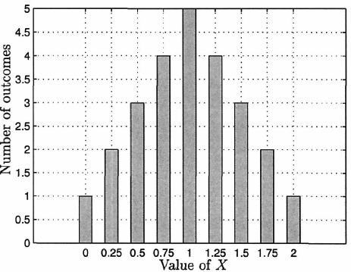
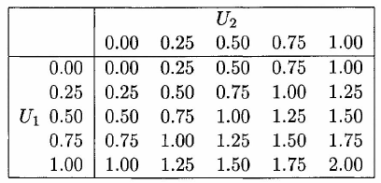


Why Use Computer Simulation?
Histogram for $X=U_{1}+U_{2}, M=25$
Possible values for $X=U_{1}+U_{2}$
We have learned about what happens when outcomes of experiments are added together by employing computer simulation.
Figure and table sources: S. M. Kay, Intuitive Probabilty and Random Processes Using MATLAB, Springer, 2006.

Slide 20
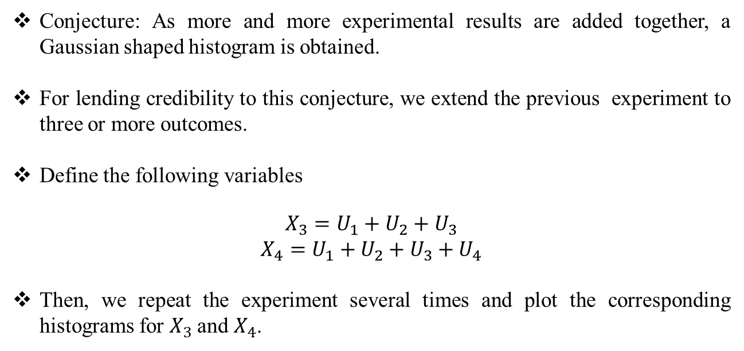
Why Use Computer Simulation?
Conjecture: As more and more experimental results are added together, a Gaussian shaped histogram is obtained.
For lending credibility to this conjecture, we extend the previous experiment to three or more outcomes.
Define the following variables
$$\begin{matrix}X_{3}=U_{1}+U_{2}+U_{3} \\ X_{4}=U_{1}+U_{2}+U_{3}+U_{4}\end{matrix}$$
Then, we repeat the experiment several times and plot the corresponding histograms for $X_{3}$and $X_{4}$.

Slide 21
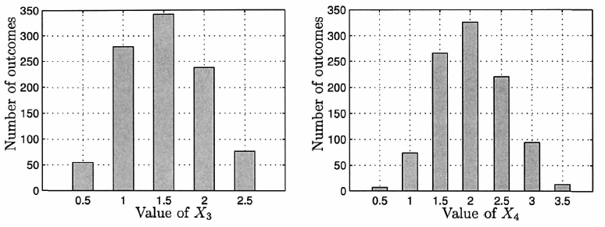
Why Use Computer Simulation?
Histograms for addition of outcomes,$M=1000$
Histograms appear more like a Guassian curve. Computer simulations indicate what we need to prove. However, they can not be used to prove theorems.
Figure source: S. M. Kay, Intuitive Probabilty and Random Processes Using MATLAB, Springer, 2006.

Slide 22
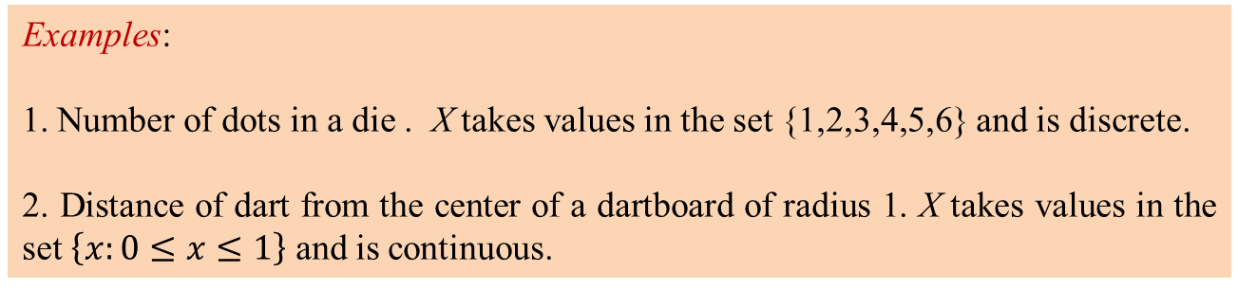
Computer Simulation of Random Experiments
Definition: A random variable X is the numerical outcome of an experiment.
Examples:
1. Number of dots in a die . X takes values in the set {1,2,3,4,5,6} and is discrete.
2. Distance of dart from the center of a dartboard of radius 1. X takes values in the set $\left\{x:0≤x≤1\right\}$ and is continuous.
Notation: We denote the random variable by a capital letter, say X , and its possible values by a small letter, say $x_{i}$ for the discrete case and x for the continuous case.

Slide 23
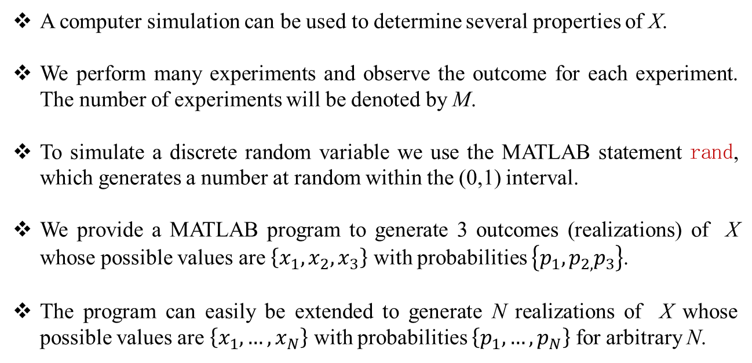
Computer Simulation of Random Experiments
A computer simulation can be used to determine several properties of X.
We perform many experiments and observe the outcome for each experiment. The number of experiments will be denoted by M.
To simulate a discrete random variable we use the MATLAB statement rand, which generates a number at random within the (0,1) interval.
We provide a MATLAB program to generate 3 outcomes (realizations) of X whose possible values are $\left\{x_{1},x_{2},x_{3}\right\}$ with probabilities $\left\{p_{1},p_{2,}p_{3}\right\}$.
The program can easily be extended to generate N realizations of X whose possible values are $\left\{x_{1}, …,x_{N}\right\}$ with probabilities $\left\{p_{1}, …,p_{N}\right\}$ for arbitrary N.

Slide 24
Computer Simulation of Random Experiments
M = 1000;
x = zeros(M,1);
x1 = 3;
x2 = 7;
x3 = 9;
p1 = 0.2;
p2 = 0.5;
for i = 1:M i = 1:M
u = rand(1,1);
if u <= p1
x(i,1) = x1;
elseif u <= (p1+p2)
x(i,1) = x2;
else
x(i,1) = x3;
end
end
Note: For a continuous random variable X that is Gaussian, the MATLAB statement rand(M,1) generates M realizations of X. Later, we will see how to generate realizations of other continuous random variables.

Slide 25
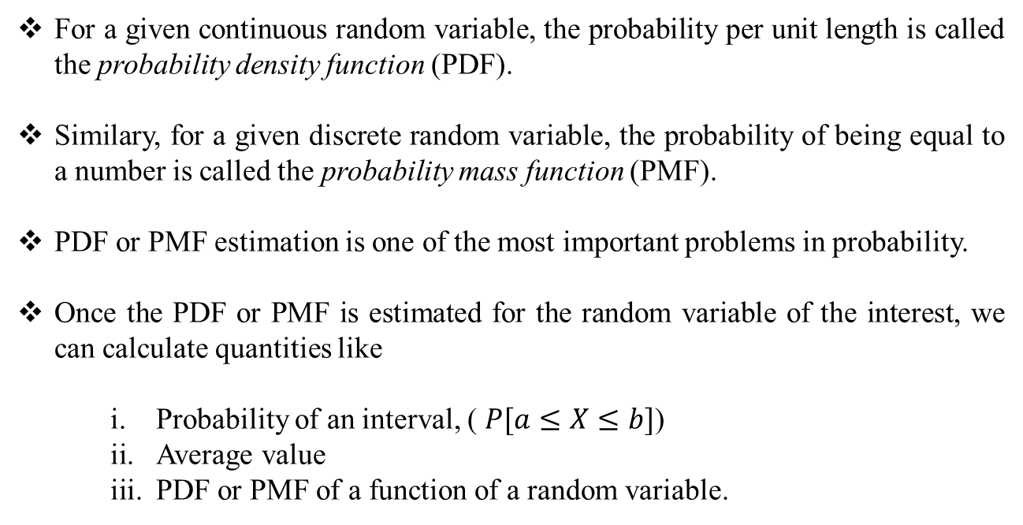
Determining Characteristics of Random Variables
For a given continuous random variable, the probability per unit length is called the probability density function (PDF).
Similary, for a given discrete random variable, the probability of being equal to a number is called the probability mass function (PMF).
PDF or PMF estimation is one of the most important problems in probability.
Once the PDF or PMF is estimated for the random variable of the interest, we can calculate quantities like
Probability of an interval, ( $P[a≤X≤b]$)
Average value
PDF or PMF of a function of a random variable.

Slide 26
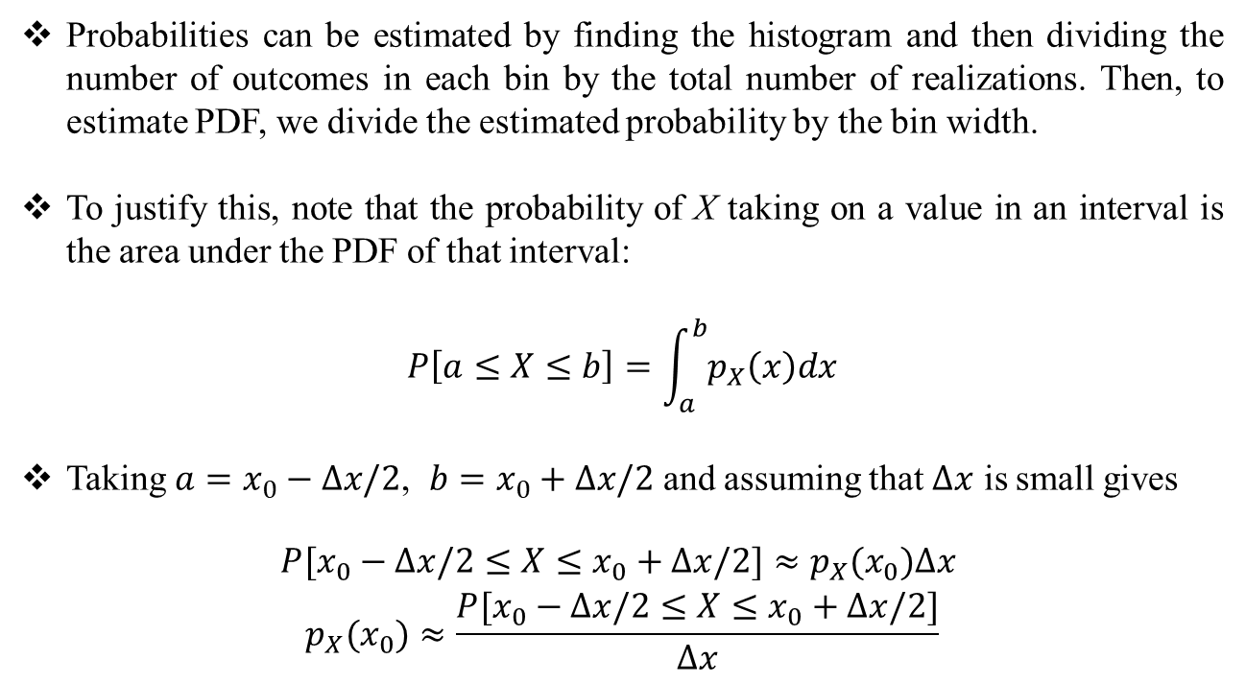
Determining Characteristics of Random Variables
Example (PDF Estimation):
Probabilities can be estimated by finding the histogram and then dividing the number of outcomes in each bin by the total number of realizations. Then, to estimate PDF, we divide the estimated probability by the bin width.
To justify this, note that the probability of X taking on a value in an interval is the area under the PDF of that interval:
$$P\left[a≤X≤b\right]=\int_{a}^{b}{p_{X}\left(x\right)dx}$$
Taking $a=x_{0}−∆x/2$, $b=x_{0}+∆x/2$ and assuming that $∆x$ is small gives
$$\begin{matrix}P[x_{0}−∆x/2≤X≤x_{0}+∆x/2]≈p_{X}(x_{0})∆x \\ p_{X}(x_{0})≈\frac{P[x_{0}−∆x/2≤X≤x_{0}+∆x/2]}{∆x}\end{matrix}$$

Slide 27
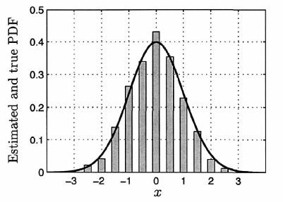
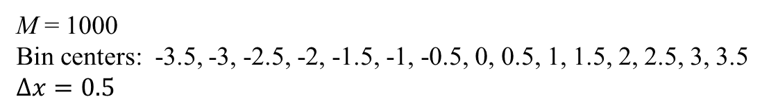
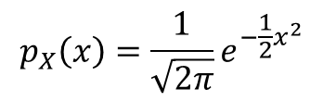
Determining Characteristics of Random Variables
M = 1000
Bin centers: -3.5, -3, -2.5, -2, -1.5, -1, -0.5, 0, 0.5, 1, 1.5, 2, 2.5, 3, 3.5
$∆x=0.5$
True PDF:
$$p_{X}\left(x\right)=\frac{1}{\sqrt{2π}}e^{−\frac{1}{2}x^{2}}$$
Estimated and true PDFs for a Gaussian random variable.
Figure source: S. M. Kay, Intuitive Probabilty and Random Processes Using MATLAB, Springer, 2006.

Slide 28
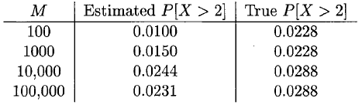
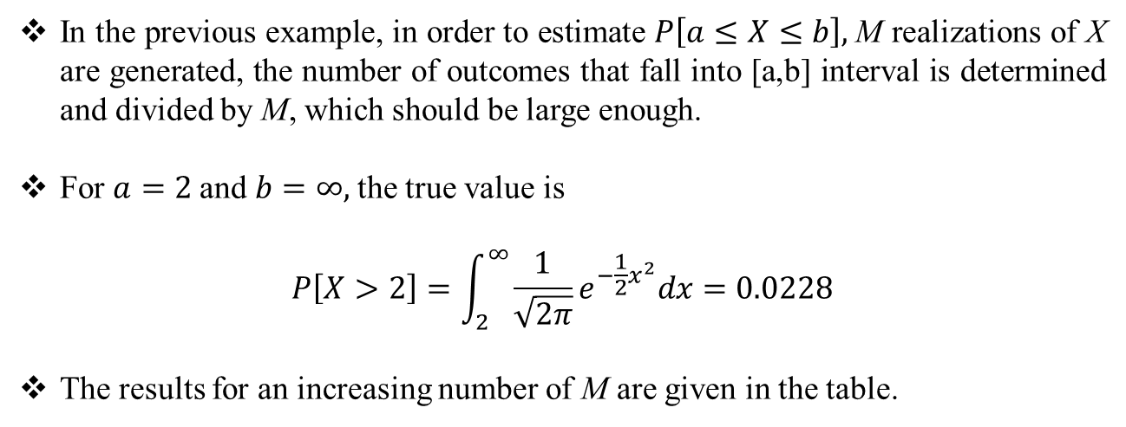
Determining Characteristics of Random Variables
Example (Probability of an interval):
In the previous example, in order to estimate $P\left[a≤X≤b\right],$M realizations of X are generated, the number of outcomes that fall into [a,b] interval is determined and divided by M, which should be large enough.
For $a=2$and $b=∞,$the true value is
$$P\left[X>2\right]=\int_{2}^{∞}{\frac{1}{\sqrt{2π}}e^{−\frac{1}{2}x^{2}}dx}=0.0228$$
The results for an increasing number of M are given in the table.
Table source: S. M. Kay, Intuitive Probabilty and Random Processes Using MATLAB, Springer, 2006.

Slide 29
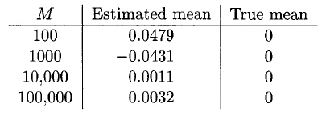
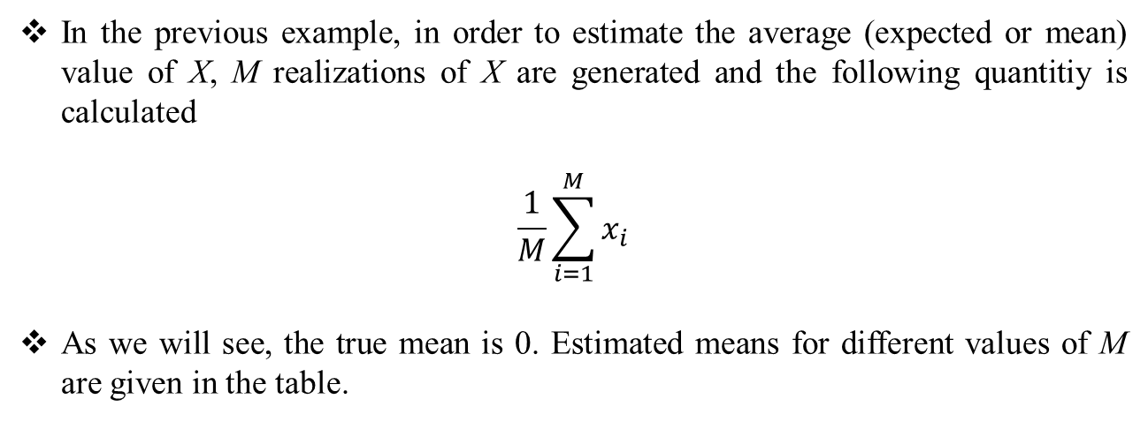
Determining Characteristics of Random Variables
Example (Average Value):
In the previous example, in order to estimate the average (expected or mean) value of X, M realizations of X are generated and the following quantitiy is calculated
$$\frac{1}{M}\sum_{i=1}^{M}{x_{i}}$$
As we will see, the true mean is 0. Estimated means for different values of M are given in the table.
Table source: S. M. Kay, Intuitive Probabilty and Random Processes Using MATLAB, Springer, 2006.

Slide 30
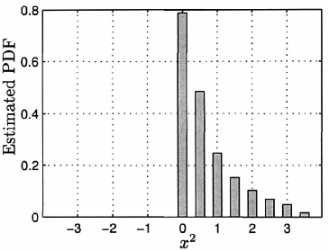
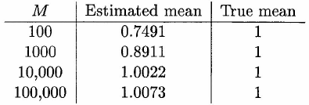
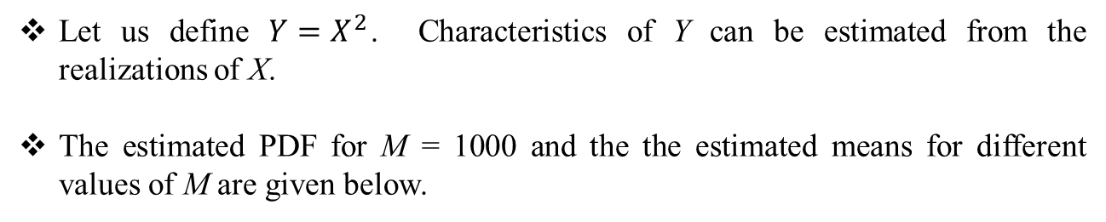
Determining Characteristics of Random Variables
Example (Transformation of a Random Variable):
Let us define $Y=X^{2}$. Characteristics of Y can be estimated from the realizations of X.
The estimated PDF for M = 1000 and the the estimated means for different values of M are given below.
Table and figure sources: S. M. Kay, Intuitive Probabilty and Random Processes Using MATLAB, Springer, 2006.

Slide 31
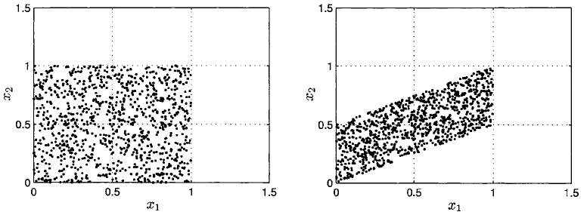
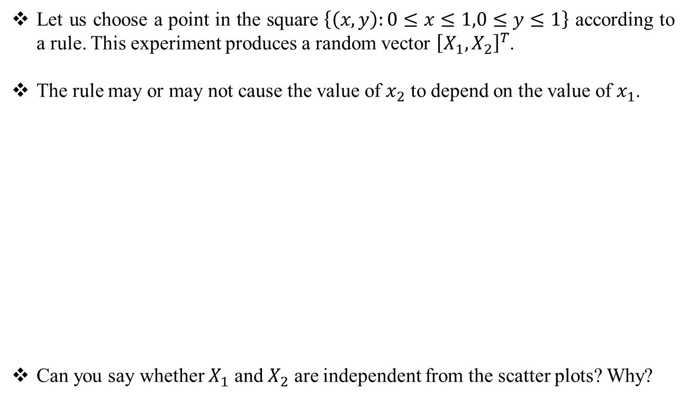
Determining Characteristics of Random Variables
Example (Multiple Random Variables):
Let us choose a point in the square $\left\{\left(x,y\right):0≤x≤1,0≤y≤1\right\}$ according to a rule. This experiment produces a random vector ${\left[X_{1},X_{2}\right]}^{T}$.
The rule may or may not cause the value of $x_{2}$ to depend on the value of $x_{1}$.
Can you say whether $X_{1}$ and $X_{2}$ are independent from the scatter plots? Why?
M = 1000
M = 1000
Figure source: S. M. Kay, Intuitive Probabilty and Random Processes Using MATLAB, Springer, 2006.

Slide 32
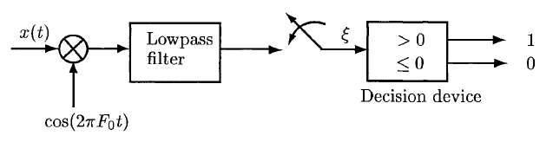
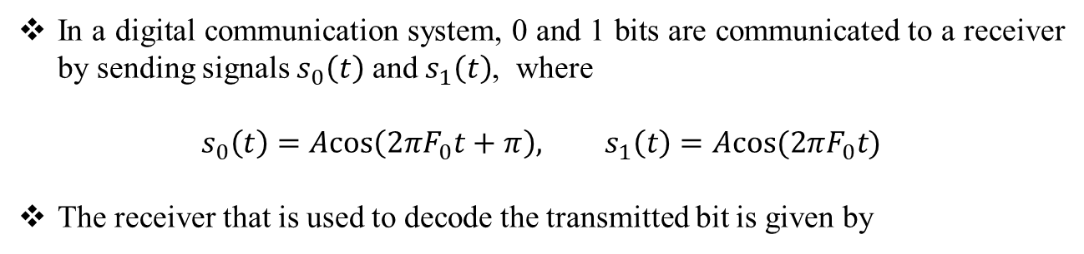
Real World Example: Digital Communication
In a digital communication system, 0 and 1 bits are communicated to a receiver by sending signals $s_{0}\left(t\right)$ and $s_{1}\left(t\right)$, where
$$s_{0}\left(t\right)=A\text{cos}\left(2πF_{0}t+π\right), s_{1}\left(t\right)=A\text{cos}(2πF_{0}t)$$
The receiver that is used to decode the transmitted bit is given by
Figure source: S. M. Kay, Intuitive Probabilty and Random Processes Using MATLAB, Springer, 2006.

Slide 33
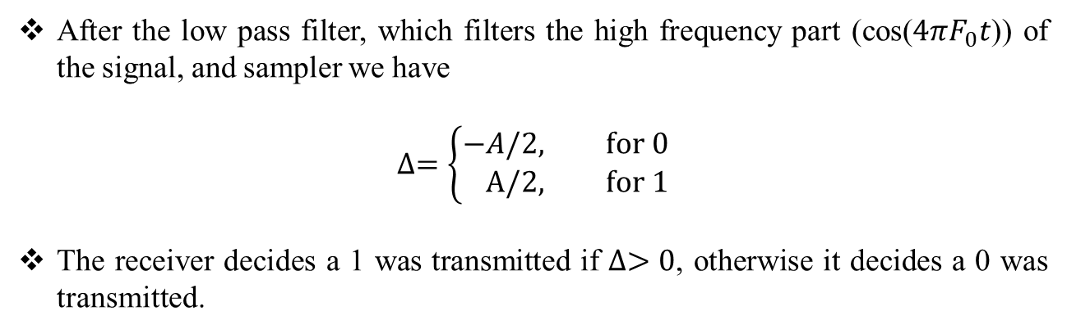
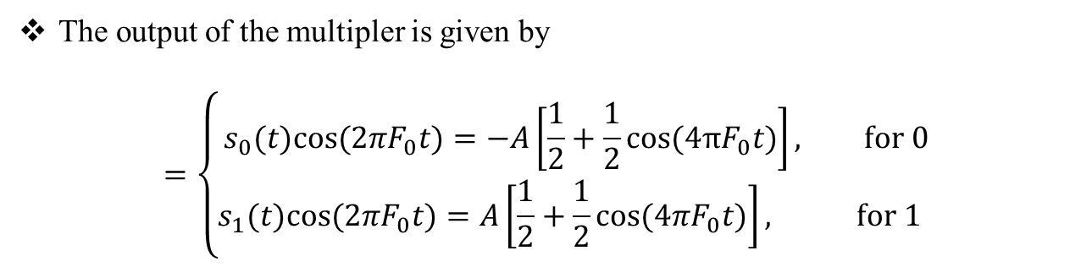
Real World Example: Digital Communication
The output of the multipler is given by
$$=\left\{\begin{aligned}s_{0}(t)\text{cos}(2πF_{0}t)=−A\left[\frac{1}{2}+\frac{1}{2}\text{cos}\text{(4}πF_{0}t\text{)}\right], \text{for} 0 \\ &s_{1}(t)\text{cos}(2πF_{0}t)=A\left[\frac{1}{2}+\frac{1}{2}\text{cos}(4πF_{0}t)\right], \text{for} 1 \end{aligned}\right.$$
After the low pass filter, which filters the high frequency part (cos($4πF_{0}t$)) of the signal, and sampler we have
$$∆=\left\{\begin{aligned}−&A/2, \text{for} 0 \\ &\text{A}\text{/2, }\text{for} 1\end{aligned}\right.$$
The receiver decides a 1 was transmitted if $∆>0$, otherwise it decides a 0 was transmitted.

Slide 34
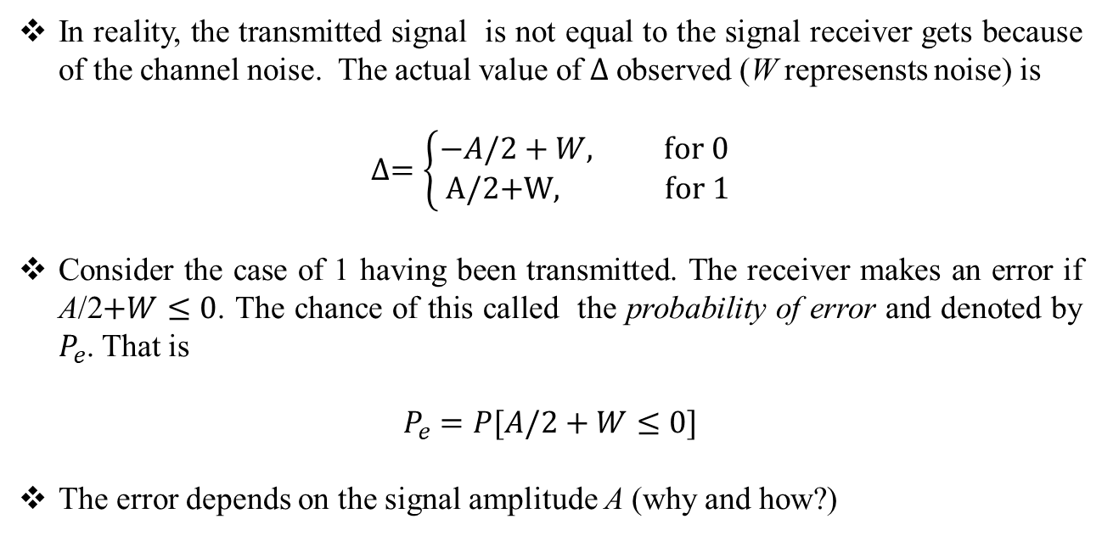
Real World Example: Digital Communication
In reality, the transmitted signal is not equal to the signal receiver gets because of the channel noise. The actual value of $∆$observed (W represensts noise) is
$$∆=\left\{\begin{aligned}−&A/2+W, \text{for} 0 \\ \text{A}\text{/2+}\text{W}\text{, } \text{for} 1\end{aligned}\right.$$
Consider the case of 1 having been transmitted. The receiver makes an error if A/2$+W≤0$. The chance of this called the probability of error and denoted by $P_{e}$. That is
$$P_{e}=P[A/2+W≤0]$$
The error depends on the signal amplitude A (why and how?)

Slide 35
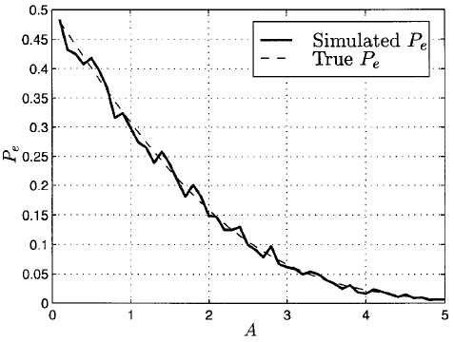
Real World Example: Digital Communication
Using a computer simulation, we can plot $P_{e}$as a function of A. Assuming noise is Gaussian gives
$P_{e}$decreases as the signal amplitude increases. What is the physical interpretation?
Figure source: S. M. Kay, Intuitive Probabilty and Random Processes Using MATLAB, Springer, 2006.

